Slide 1
Analysis of Sales Methods for New Product Line
Presented by James Carey

Slide 2
Project Overview
This project is aimed at exploring the Pens and Printers sales data to compare the different sales strategies and provide recommendations how the company can optimise sales and maximise revenue moving forward.

Slide 3
Sales Methods
The 3 sales methods are:
Email
Call
Email + Call

Slide 4
Data Validation and Cleaning
Ensured all columns were formatted as correct data type.
Ensured consistency in sales_method and state columns.
Checked for duplicate rows.
Dealt with outliers in the years_as_customer column.
Dealt with missing values in the revenue column.
Asserted all customer_ids were unique.

Slide 5
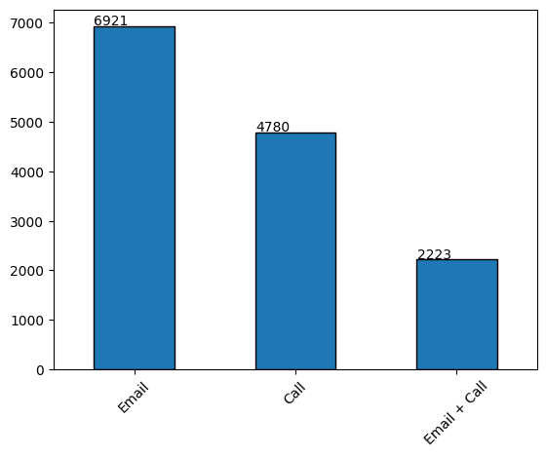
Customer Numbers
13,926 customers in the cleaned dataset.
Roughly half are Email customers.
About 1/3 are Call customers.
About 1/6 are Email + Call.

Slide 6
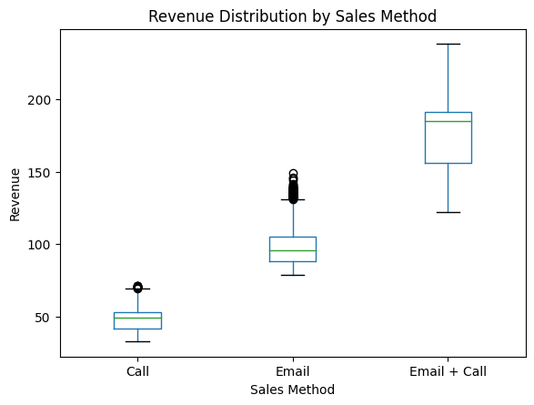
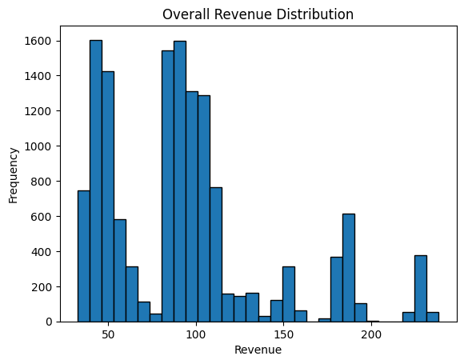
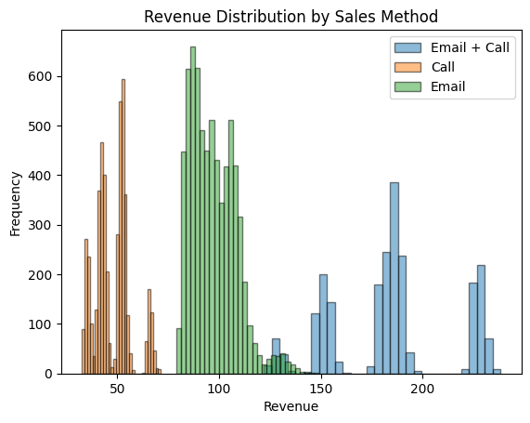
Revenue Analysis

Slide 7
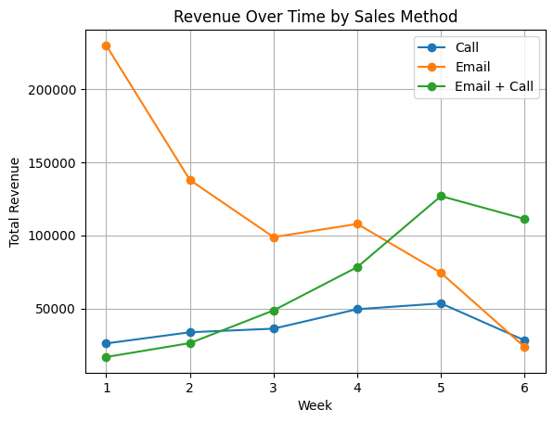
Revenue over Time
Email sales decreasing.
Email + Call customers on the rise.
Call sales relatively consistent.

Slide 8
Key Recommendations
Decreasing Email sales concerning, but given emails take little work on the team’s part and still result in decent revenue, it doesn’t make sense to discontinue this method.
Increasing Email + Call sales shows potential to grow, however using both can be resource and time-intensive.
Good approach would be to use Email for initial contact with a wide range of (potential) customers, then pivot to calling for follow-ups with engaged or high-potential customers.

Slide 9
Metric to Monitor
Average revenue per customer for each sales method.
This will allow the business to monitor any changes in the effectiveness of each sales method over time.
Monitor monthly.
Initial (current) values:
Call: $49.29
Email: $96.90
Email + Call: $171.48

Slide 10
Next Steps
Continue with all 3 methods, but use email for a broad audience and use calls for follow-ups with select engaged or high-potential customers.
This balances maximising reach with conserving company resources and time.
Monitor Avg revenue per customer for each method monthly.
Any questions?

